Slide 1


WELCOME TO OUR
PRESENTATION

Slide 2

Our topic is

Slide 3
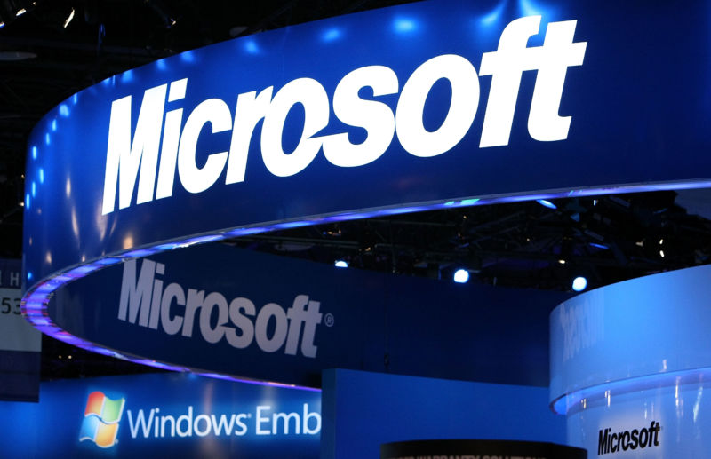

Slide 4
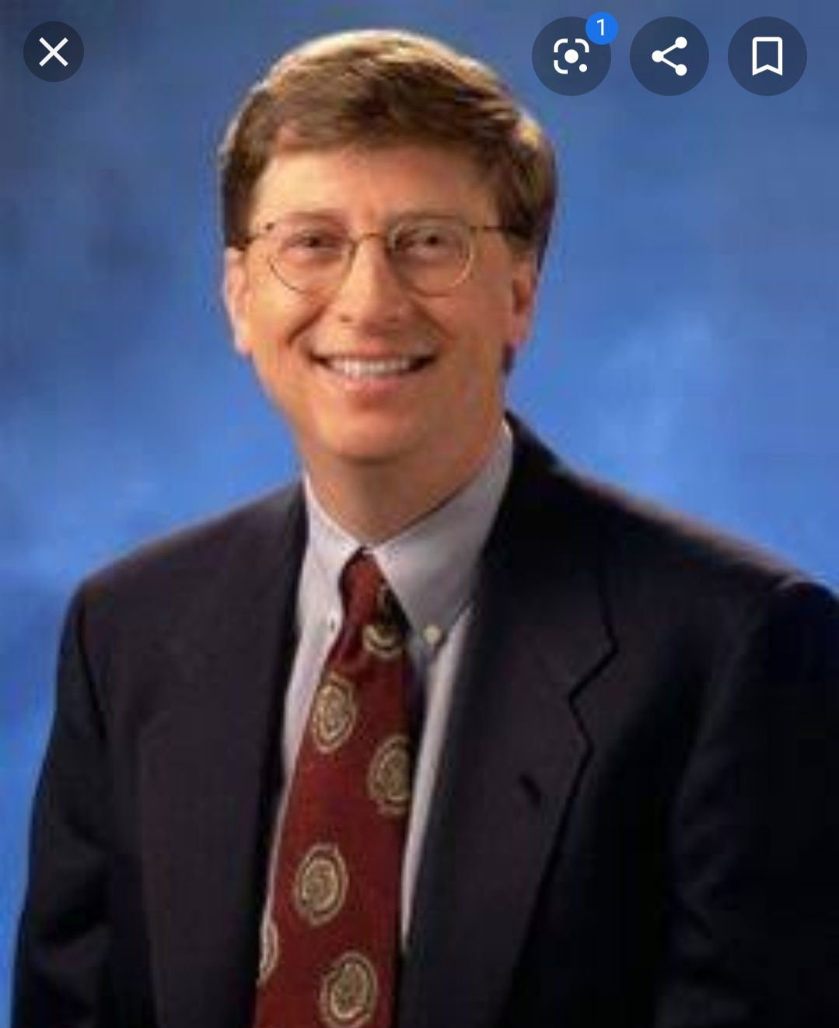

MICROSOFT
MICROSOFT CORPORATION IS AN AMERICAN MULTINATIONAL COMPANY HEADQUARTERS IN REDMOND , WASHINGTON. IT DEVELOPS, MANUFACTURES , LICENSES, SUPPORT, AND SELLS COMPUTER SOFTWARE, CONSUMER ELECTRONICS, PERSONAL COMPUTER , AND RELATED SERVICESS

Slide 5

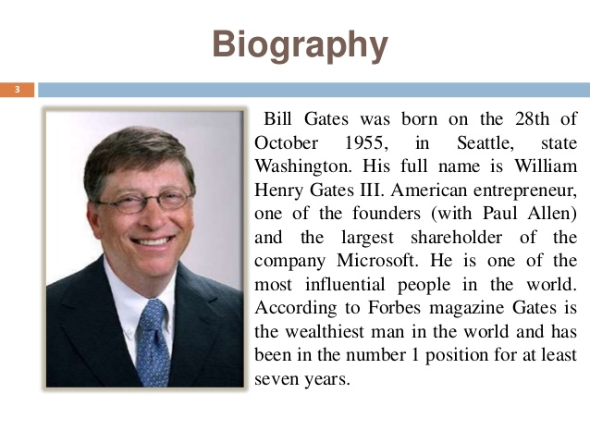
Microsoft was founded by
BILL GATES

Slide 6

PRESENTING SOME BEST APPLICATIONS OF MICROSOFT

Slide 7
APPLICATIONS OF MICROSOFT
MS EXCELL
MS WORD
MS POWERPOINT

Slide 8

MS EXCELL {.XLSX}
MS EXCELL IS SPREADSHEET PROGRAM . THAT MEANS IT IS USE TO CREATE GRIDS OF TEXT, NUMBERS AND FORMULAS SPECIFIING CALCULATION, THAT IS EXTREMELY VALUABLE FOR MANY BUSINESSES , WHICH USE IT TO RECORD EXPENDITURES AND INCOME , PLAN BUDGETS , CHART DATA AND SUCCINCTLY PRESENT FISCAL RESULT.

Slide 9


MS WORD {.docx}
A FILE WITH THE .DOCX FILE EXTENSION IS A MICROSOFT WORD OPEN XML FORMATE DOCUMENT FILE. DOCX FILE ARE USED FOR EVERTHINK FROM RESUMES AND COVER LETTER TO REPORTS, FLYERS , DOCUMENTATION ,INVITATIONS , NEWSLETTER , AND MORE.

Slide 10


MS POWER POINT {.pptx}
MS .ppt is A PRESENTATION PROGRAM ,CREATED BY GASKINS AND DENNIS AUSTIN AT A SOFTWARE COMPANY FORETHOUGHT , INC. IT WAS RELEASED ON APRIL 20 ,1987, INITIALLY FOR MACINTOSH COMPUTER ONLY .

Slide 11


PRESENTED BY
OUR GROUP ‘AANSH’
APOORVA
ANCHAL
NIKITA
SHUSHMA
HABIBA
PRARTHANA

Slide 12

THE END

